Slide 1
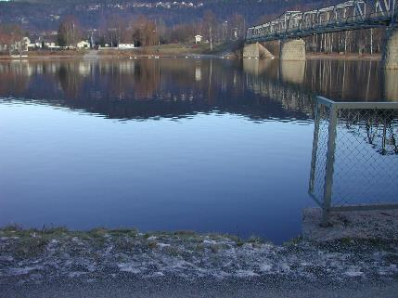
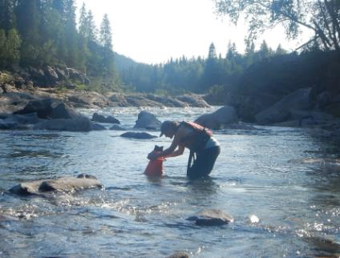
The Norwegian River Monitoring programme (Elveovervåkingsprogrammet)
PL NIVA: Øyvind Kaste (co-PL: Cathrine Brecke Gundersen)
PS responsible: Camilla Folkestad
Economy responsible: Karoline Slettebø
Lab coordinator: Marit Villø / Kine Bæk
Miljøinformatikk: Benno Dillinger
Institutes: NIVA
Subcontractors: NVE, NINA, NORCE, NIBIO
Program started in 1990 (current cycle: 2021-2025)
Ca. MNOK pr. year: 9-10
Foto: NIVA
Foto: Maia Røst Kile

Slide 2
Key personell
From NIVA: |  | Subcontractors:
Øyvind Kaste Cathrine B. Gundersen Maia Røst Kile Liv Bente Skanke Maeve McGovern Camilla Folkestad Jonas Persson Sissel B. Ranneklev Marit Villø Kine Bæk | Marthe T. S. Jenssen Ian Allan James E. Sample Dag Ø. Hjermann Odd Arne Skogan Rolf Høgberget Benno Dillinger Tor Erik Eriksen Sverre Hjelseth | Knut Marius Myrvold (NINA) Jon Museth (NINA) Gaute Velle (NORCE) Christian Lucien Bodin (NORCE) Morten Nordahl Due (NVE) Trine Fjeldstad (NVE) Stein Beldring (NVE) Eva Skarbøvik (NIBIO)
40 persons at NIVA put hours on the project in 2022

Slide 3
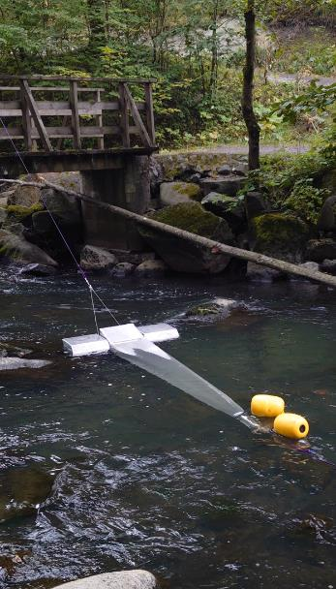
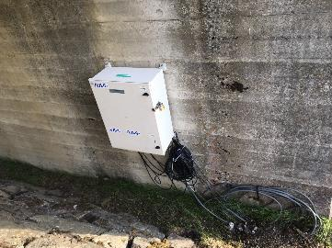
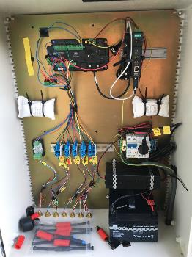
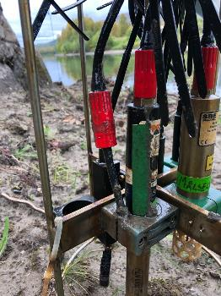
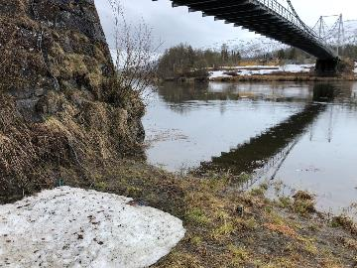
Plast-prøvetaking, Alna (foto: Sverre Hjelseth)
Sensor-stasjon, Målselva (foto: Odd Arne Skogan)

Slide 4
Aim of the program
Monitor status and long-term trends for nutrient and contaminant concentrations in Norwegian rivers
Provide data for classification of Norwegian rivers according to the requirements of the WFD
Reveal water quality changes that can be attributed to climate change or other human influences
Increase the knowledge base on climate processes affecting the water environment
Increase current knowledge related to the fates of emerging contaminants in aquatic ecosystems
Provide data that may explain changes in eutrophication and contaminant levels along the Norwegian coast
Estimate riverine inputs and direct discharges of nutrients and contaminants to Norwegian coastal waters (for reporting under the OSPAR Convention)

Slide 5
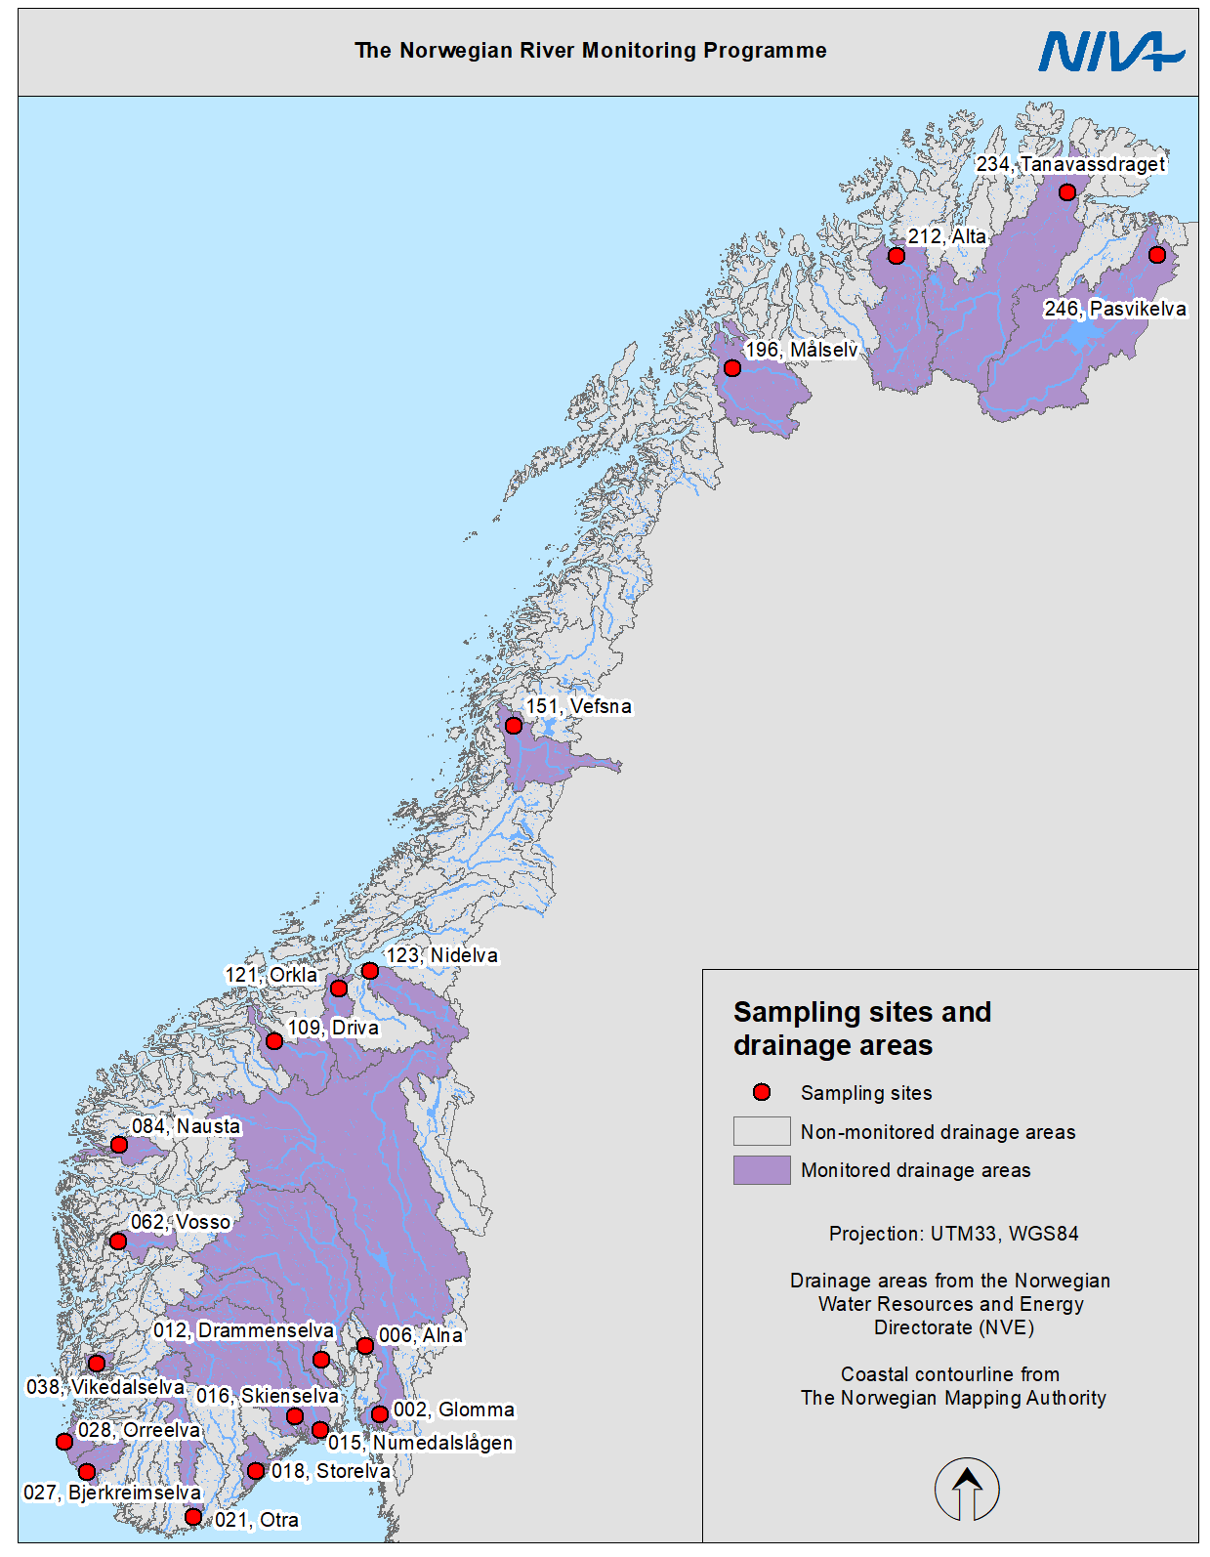
Monitoring program
20 Main rivers
General water chemistry (monthly)
Metals (4 times/yr)
Contaminants (5 rivers per year)
Sensor stations (5 stations in 3 rivers)
15-20 «BIO» rivers
Water chemistry
Benthic algae
Benthic invertebrates
Fish
Implemented options
Monitoring of rivers affected by mining
Contaminants in biota
Microplastic sampling

Slide 6
Challenges
No big challenges
Adaptation of the programme to budget cuts can be time consuming
The budgets are generally tight, but manageable
Snow and ice can complicate sampling during winter (important with close dialogue with locally hired personnel to ensure that safety comes first!)
Samples lost during postal transport is becoming an increasing problem
Previous challenge with Tot-N analysis solved!

Slide 7
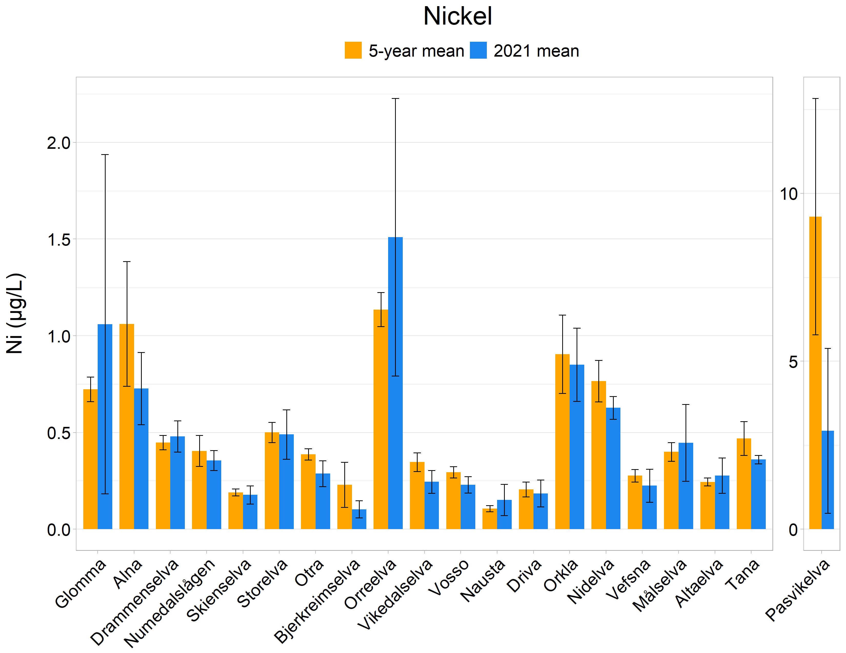
Results (one highlight)
Pasvikelva has showed a large reduction in concentrations of copper and nickel after shutdown of the nickel smelter on the Russian side of the border in December 2020.

